Slide 1


The right thing is the smart thing.
The business case against promoting tobacco to kids in movies and TV shows
University of California, San Francisco, Center for Tobacco Control Research and Education | August 2020 |
https://bit.ly/sfm-casebook2020
Notes:
PRESENTER: Welcome to the briefing, The right thing is the smart thing: The business case against promoting tobacco to kids in movies and TV shows.
This presentation was prepared by the University of California, San Francisco, Center for Tobacco Control Research and Education, in August 2020.
For citations, please see the SFM Business Case booklet (bit.ly/sfm-casebook2020).
<CLICK TO ADVANCE>

Slide 2

When kids are at greater risk…
5-year tobacco performance (2014-19)
 | Number of tobacco incidents in films |  | In-theater audience exposure
 | Youth-rated | R-rated | Youth-rated | R-rated
MPA-member companies | No change | Up 130% | Down 14% | Up 216%
Independents | Up 199% | Up 134% | Up 363% | Up 139%
TOTAL | Up 63% | Up 132% | Up 51% | Up 202%
Notes:
PRESENTER: Why are kids still starting to smoke and vape? And why are we seeing more smoking in US movies and TV shows? The two questions are connected.
Tobacco content and exposure are increasing, overall, in top-grossing US movies released in theaters first and then on streaming channels with no age gates. Most of the companies making these movies are commissioning original streaming shows with tobacco content, as well.
This chart shows that tobacco content (incidents) and audience exposure are up by more than half in films youth-rated PG/PG-13 over the past five years. Tobacco content and exposure have more than doubled in R-rated films over the same period.
<CLICK TO ADVANCE>

Slide 3
…big media companies are at greater risk.
56% of film titles feature smoking (2002-2019)
On-Demand | Company | Subscribers | Titles
Amazon Prime | Amazon.com | 66 million | 18,405
Apple TV+ | Apple | 34 million | 7
CBS All Access | ViacomCBS | 16 million | 177
Disney+ | Disney | 50 million | 660
HBO Max | AT&T | 10 million | 1,780
Hulu | Disney | 32 million | 780
Netflix | Netflix | 61 million | 4,563
Starz | Lionsgate | 11 million | 970
Xfinity X1 | Comcast | 21 million | 8,300
Notes:
PRESENTER: Since 2002, according to content surveys by UCSF and Breathe California, more than half of all top-grossing films have featured smoking, including 51% of movies released in 2019. Overall, 44% of PG-13 films and more than 70% of R-rated movies featured tobacco imagery.
Movie inventories differ among companies, and not all films on streaming services are top-grossing movies, but it’s probable that about half of the total movie inventories now accessible to kids feature smoking.
So do most of the original streaming shows most popular with teens, according to recent studies by the Truth Initiative, the tobacco prevention foundation funded out of the states’ multibillion-dollar Master Settlement Agreement with US tobacco companies in 1998.
<CLICK TO ADVANCE>

Slide 4
A uniquely dangerous public health threat
Tobacco kills 500,000 Americans yearly.
  Tobacco is the #1 cause of preventable death in the United States and worldwide.
Tobacco will kill 1 billion people in this century, globally.
  Young US smokers and vapers are 5-7X more likely to be infected with COVID-19. Smokers hospitalized with COVID-19 are 2X more likely to deteriorate, even to die.
Notes:
PRESENTER: What makes tobacco uniquely dangerous? It kills nearly half a million Americans annually, making it the #1 cause of preventable death in the United States — and the world.
Globally, tobacco is projected to kill one billion people in this century, unless its growth is stopped. More then eight million human beings are killed by smoking each year now, more twice as many as are tragically killed by TB, malaria, HIV/AIDS, COVID-19, Ebola and armed conflict combined (3.35 million).
The most recent global virus pandemic, COVID-19, is made worse by smoking. Currently available data indicate that, among people with COVID-19, smokers are twice as likely to deteriorate as non-smokers, progressing to intensive care and even dying. Just as important, young U.S. vapers are 5-7 times as likely to be diagnosed with COVID-19 as young non-users.
<CLICK TO ADVANCE>

Slide 5
Warnings issued by top health authorities
U.S. Surgeon General (2014):
  Exposure to on-screen smoking causes young people to smoke.
US Centers for Disease Control and Prevention (CDC, 2016);
  On-screen smoking will recruit more than 6 million new young smokers in this generation. Two million of them will die from tobacco diseases.
Notes:
PRESENTER: Tobacco on screen kills in real life. In 2014, the US Surgeon General concluded that exposure to on-screen smoking causes young people to smoke. Much stronger than an “association,” this thoroughly vetted scientific finding is on a par with the Surgeon General’s 1964 conclusion that smoking causes lung cancer.
In 2016, the CDC projected that exposure to on-screen smoking would recruit more than six million new young US smokers, in this generation. Two million of them will die from tobacco-induced diseases.
Tobacco addiction is a pediatric disease. More than 80% of smokers are hooked before they reach age 18. Tobacco and media companies that target the same young audiences have been a deadly combination.
<CLICK TO ADVANCE>

Slide 6
Tobacco has bought its way on screen for a century
STUDIO ERA
CROSS PROMOS
MADISON
AVENUE
PRODUCT
PLACEMENT
BACK
TO TV
Stars smoke on screen.
Studios broker millions
in stars’ tobacco ad fees.
Tobacco companies pay
for Hollywood studios’
national print and radio
advertising.
Tobacco
companies
own TV shows
or control
program
content as
sponsors.
Banned from
broadcasting,
Big Tobacco
systematically
pursues brand
and product
placement in
600+ movies.
Smoking on
screen peaks
at levels not
seen in half
a century.
Smoking grows
on streaming
channels.
1920 1930 1940 1950 1960 1970 1980 1990 2000 2020
Notes:
PRESENTER: But you need not rely on scientific research to make the screen-tobacco connection. For a century, Big Tobacco has invested many millions to promote its products through entertainment media.
Briefly, this marketing can be tracked through four phases. From the late 1920s into the 1950s, tobacco companies gave movie studios incentives to smoke on screen, paying off three-quarters of top stars and essentially paying for all the studios’ national advertising in newspapers, magazines and on radio.
When TV came in, Big Tobacco made deals with many of the same big media companies to sponsor shows and push tobacco content between the commercials. When Congress banned tobacco commercials from TV and radio in 1970, Big Tobacco launched systematic product placement campaigns that influenced hundreds of Hollywood movies, 40% of them youth-rated.
Finally, despite mounting pressure on major studios to reduce exposure from kid-rated movies, in recent years, smoking has migrated to streaming channels, where R-rated movies with heavy smoking are openly accessible to kids and original TV series are full of smoking. 55% of Netflix’ kid-rated movies include smoking, as do 72% of its mature-rated shows.
<CLICK TO ADVANCE>

Slide 7
Today’s media brands with a tobacco history
(Present owner)
STUDIO ERA
CROSS PROMOS
MADISON
AVENUE
PRODUCT
PLACEMENT*
BACK
TO TV**
Columbia (Sony)
Fox (Disney)
MGM (MGM Holdings)
Paramount (ViacomCBS)
Universal (Comcast)
Warner Bros. (AT&T)
ABC (Disney)
CBS (ViacomCBS)
NBC (Comcast)
Warner Bros. (AT&T)
Universal (Comcast)
Disney (inc. Fox)
Lionsgate
MGM Holdings
Miramax (Colony)
Columbia (Sony)
Paramount (ViacomCBS)
Village Roadshow
AMC Networks
AT&T
Disney (inc. Fox)
Netflix
ViacomCBS
1920 1930 1940 1950 1960 1970 1980 1990 2000 2020
* 600 film releases reported as engaged in tobacco industry documents.
** Sample confined to 25 scripted TV shows most popular with younger viewers.
Notes:
PRESENTER: Many of the media companies historically engaged in tobacco promotion still exist, although they may have different ownership. Their movie lists may still be largely intact and available under license to any distributor or streamed on demand.
Survivors with tobacco records include all the present-day major-studio members of the Motion Picture Association (MPA). Some companies, like Sony, produce TV programs for other companies.
<CLICK TO ADVANCE>

Slide 8
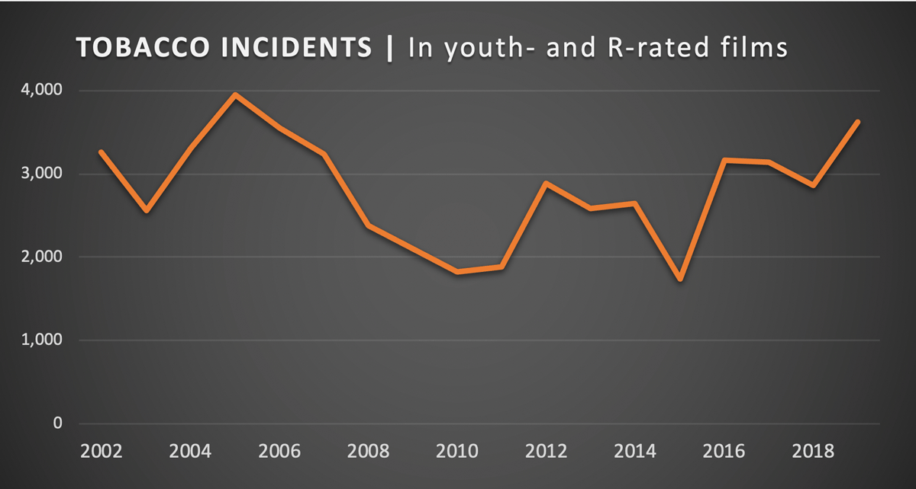
On-screen smoking has rebounded in the last five years
+ 108%
Sample: All 2,595 top-grossing U.S. films 2002-19
Source: UCSF-Breathe California Onscreen Tobacco Database
Notes:
PRESENTER: Since 2015, smoking in U.S. top-grossing films of all ratings has more than doubled.
While the amount of smoking in youth-rated films has been largely flat since 2010, smoking in R-rated films has increased substantially.
The difference over this time period? R-rated films packed with smoking are now accessible to kids 24-7 on screens as small as a phone.
Something else to notice in this chart? There’s more smoking in movies today than there was nearly two decades ago. Top-grossing movies contained 3,618 tobacco incidents in 2019, 11% more than in 2002, when this survey of tobacco content started.
<CLICK TO ADVANCE>

Slide 9
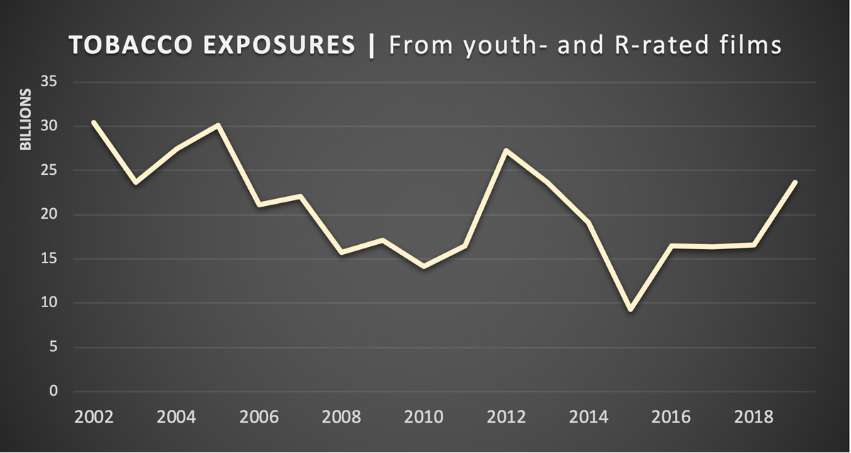
Audiences’ tobacco exposure is also nearing record highs
+ 155%
Exposures = Tobacco incidents in a film X paid admissions,
not including home video exposures.
Notes:
PRESENTER: How much tobacco exposure is delivered to domestic moviegoers? While youth-rated exposure from major studio movies has fallen, audience exposure from these same companies’ R-rated movies has more than tripled in the last five years, from 6 billion to 19 billion tobacco impressions.
Measuring on-screen tobacco exposure is vital because the research indicates that kids’ cumulative exposure is what causes them to smoke. For US kids, the risk doubles as exposure increases.
While this chart measures trends, it doesn’t show total amounts. The movie industry’s own published data shows that movies are now watched fourteen times more often, per capita, on digital media than in theaters. But data on the size of digital audiences, per title, is hard to come by: the companies refused US Senators’ requests to share child-safety data just last year. American kids may be exposed to more tobacco promotion on screens today than they were at the height of multibillion-dollar cigarette advertising campaigns on network TV a half-century ago.
<CLICK TO ADVANCE>

Slide 10
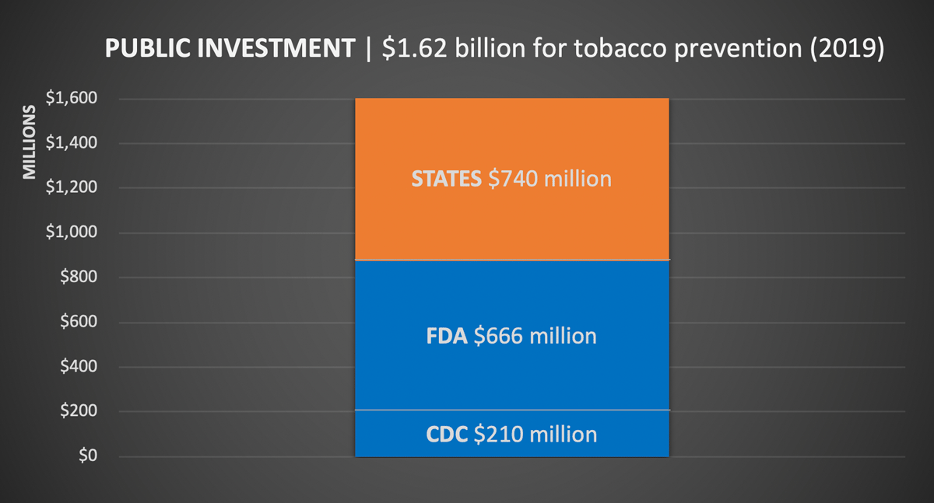
Big Tobacco spent $9.1 billion on promotion in 2019
States’ spending includes a fraction of their tobacco tax revenues
and tobacco settlement funds.
Notes:
PRESENTER: There’s a solid national consensus that the tobacco industry should not market to kids. Congress banned tobacco advertising on TV and radio in 1970. And while states and the federal government spend less than needed to keep kids from starting and unhook adult users, they did invest $1.62 billion in tobacco control and prevention in 2019.
For comparison, the tobacco industry spends nearly six times as much to push smoking as states spend to stop it. And states spent less than one-quarter of their own tobacco tax revenues and 1998 tobacco settlement funds to protect their populations than the CDC recommends.
Tobacco’s national cost per capita last year, in health care expenses and productivity losses added up? More than $2,000 per family of four ($170 billion / 330 million Americans).
It will cost taxpayers nothing for big media companies to simply stop pushing tobacco at kids.
<CLICK TO ADVANCE>

Slide 11
U.S. restrictions on marketing tobacco to children
STATE & LOCAL
restrictions
FEDERAL
Family Smoking
Prevention and
Tobacco Control
Act (2009)
1998
MASTER
SETTLEMENT
AGREEMENT
1999-2018
U.S. v. Philip
Morris
• State licenses and
inspections.
• Flavor bans.
• Age minimums:
19 states, DC and
530 localities have
raised age to 21.
Big U.S. tobacco
companies are found
liable for violating
civil racketeering
laws by lying about
health risks and for
marketing to kids.
• U.S. tobacco firms
and state Attorneys
General prohibited
brand placement
deals in U.S., among
other marketing
practices.
• Empowered FDA to
regulate tobacco and
nicotine products.
• Restored 1996 law’s
marketing limits, subject
to court challenges.
Notes:
PRESENTER: States, localities and the national government have long battled to hold the tobacco industry accountable and hold the line on exploitive marketing.
The Federal Trade Commission first went after paid celebrity endorsements from movie stars and others in 1929 and again in 1942. Primarily to protect children, US cigarette commercials were banned in 1970. In 1989, Capitol Hill held hearings on tobacco product placement in screen.
In 1998, state Attorneys General made a prohibition on tobacco brand placement in media accessible to kids part of the Master Settlement Agreement (MSA). The prohibition applies to domestic tobacco companies, not multi-national marketers, and media companies aren’t mentioned. The MSA has so far cost tobacco companies some $140 billion.
In 2004 and 2007, the US House and Senate held hearings about Hollywood’s tobacco practices.
State and local laws address tobacco marketing to kids. So does the 2009 federal law that finally brought tobacco under FDA regulation. The federal government’s long-running civil racketeering (RICO) prosecution of US tobacco companies, against an army of tobacco industry lawyers, found the companies in violation for marketing to children.
Considering this nearly century-long record of investigation, litigation and multibillion-dollar penalties, media companies whose products promote tobacco may also face legal and regulatory risks, as well as risk to their brands’ reputations.
<CLICK TO ADVANCE>

Slide 12
Official supporters of smokefree films and TV
U.S. Surgeon
General
U.S. Centers for
Disease Control
And Prevention
State and Territorial Attorneys General
• Exposure causes
young viewers to
smoke.
• R-rating alone would
cut teen smoking rate
by nearly 20%.
“Each time a member of the industry releases another movie that depicts smoking, it does so with the full knowledge of the harm it will bring to children who watch it.”
• Annual surveillance
reports on tobacco
content and individual
company performance.
• Repeated reports in
the CDC’s official journal,
Morbidity and Mortality
Weekly Report (MMWR).
Notes:
PRESENTER: In particular, the Surgeon General has reported that R-rating future movies with smoking would reduce teen smoking rates by nearly 20%. This will prevent a million tobacco deaths in this generation.
As recently as August 2019, a record number of state Attorneys General (43) have asked media companies to take specific actions. The AGs have called on-screen smoking a “colossal, preventable tragedy” and are on record telling the movie companies that they are knowingly harming children.
Public health agencies including the New York State Dept. of Health and Los Angeles County also endorse smokefree media solutions.
<CLICK TO ADVANCE>

Slide 13
Harms and costs of screen smoking
37%
On-screen smoking is the primary recruiter of new young smokers in the U.S. and U..S. movies and TV are the most important on-screen recruiters globally.
Will recruit 6.4 million new young smokers
in this generation, in the U.S. alone…
6.4
million
of whom 2 million will die
from tobacco-caused diseases.
2
million
Medical and productivity costs = $118.4 billion
Estimated on calculated medical costs of $67.1 billion and proportional productivity losses.
Notes:
PRESENTER: On-screen smoking accounts for 37% of new young smokers in the US each year. Studies also indicate that US movies and TV are the most important on-screen smoking promoters globally.
In the US alone, on-screen smoking will recruit 6.4 million new young smokers in this generation, of whom 2 million will die from smoking. The medical and productivity costs for this group are estimated at nearly $120 billion, with $67 billion in direct medical care costs.
If medical care costs were to be recouped by the states — going back to 2003, when the film industry was first put on notice in an L.A. meeting with studio production chiefs, researchers, AGs and others — it would cost the companies billions. If the cost of lives lost were recovered in other proceedings at the EPA’s cost per life of $9.1 million, liability could mount into the hundreds of billions.
Of course, with kids receiving even more exposure through digital media, these dismal numbers could be growing larger every day.
<CLICK TO ADVANCE>

Slide 14





Companies’ share of tobacco exposure | 2002-March 2020
Companies | Films | With smoking | Tobacco incidents | Percent of total | Impressions (billions) | Percent of total
 | 411 | 53% | 8,363 | 16% | 79.4 | 21%
 | 360 | 56% | 8,367 | 16% | 57.0 | 15%
 | 567 | 41% | 6,514 | 13% | 56.9 | 15%
 | 348 | 61% | 7,568 | 15% | 64.9 | 17%
 | 242 | 58% | 4,500 | 9% | 42.6 | 11%
 | 667 | 66% | 15,820 | 31% | 72.2 | 19%
 | 2,595 | 56% | 51,132 | 100% | 373.1 | 100%
Independents
AT&T includes WarnerMedia. Disney includes its Twentieth Century Studio division, formerly Fox. Comcast includes Universal and ViacomCBS includes Paramount. Tobacco impressions = Incidents X Paid admissions. Lower-budget indie films average smaller audiences than major studio films.
Notes:
PRESENTER: What share of the on-screen tobacco problem can be assigned to different companies? We have the most precise data for the tobacco content in movies and audience exposure in theaters.
This table adds up exposure to audiences of all ages from youth-rated and R-rated films between 2002 and March 2020. Absent more granular data, which the companies have so far declined to release, the table shows that for the past generation each of the major studios and independents as-a-group own substantial shares in the problem, as measured by tobacco impressions delivered to moviegoers.
Existing data indicates that children and teens make up abut one-quarter of the total movie-going audience. As in theaters, teens likely see as much smoking in R-rated films on streaming channels as young adults do.
<CLICK TO ADVANCE>

Slide 15
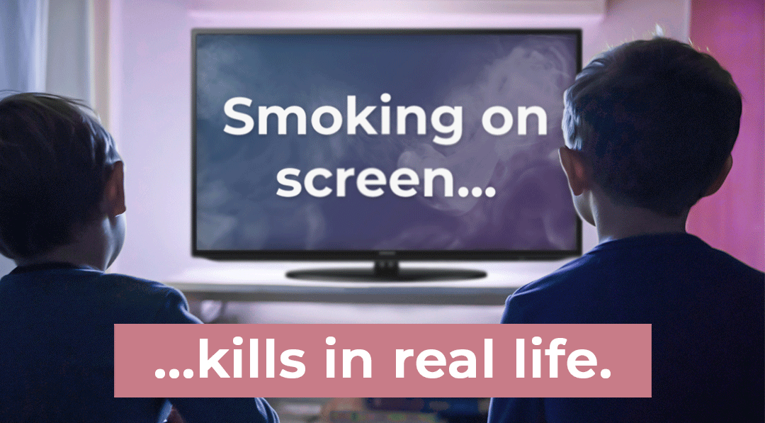
International tobacco treaty targets screen smoking
World Health Organization | Internationally-distributed poster from World No Tobacco Day 2020.
For Article 13 implementation guidelines, see www.who.int/fctc/guidelines/article_13.pdf.
Notes:
PRESENTER: The only global health treaty in the world today, with more than 180 parties, is WHO’s Framework Convention on Tobacco Control (FCTC). Its Article 13 is a binding pledge from governments worldwide to end tobacco promotion in film and TV entertainment media.
Already, China and India — representing 37% of the world population — have applied Article 13’s principle’s to domestic and foreign productions. On another continent, Nigeria and Ghana were the first to integrate on-screen warnings into national tobacco control laws. France’s health minister has instructed that country’s film industry to stop “advertising” cigarettes. (The US has signed but not ratified the treaty.)
Careful studies in more a dozen countries uniformly find that US films account for most of kids’ tobacco exposure internationally. Because 70% of Hollywood’s revenue comes from outside the US — and streaming is also growing faster overseas — it makes strategic sense for US media companies to future-proof their products by making them smokefree.
<CLICK TO ADVANCE>

Slide 16
6 forward-looking solutions for media companies
1
Rate future films and TV shows with smoking R / 18 / TV-MA
2
Give advance notice of the hazard in plain language; roll anti-tobacco PSAs
3
Stipulate that credited producers certify no tobacco pay-offs
4
End tobacco brand display on screen
5
Make projects with tobacco ineligible for generous public subsidies
6
Share audiences’ tobacco exposure data
Evidence-based policy solutions endorsed by shareholders, every leading U.S. health and medical associations, state and national health agencies (CDC), state Attorneys General, and the World Health Organization
Notes:
PRESENTER: The end their risk, media companies have been urged to adopt six evidence-based policy solutions:
• Adult ratings for future media products with tobacco (no U.S. rating scheme treats tobacco as a factor now);
• warnings before a film or TV show is selected and a strong anti-tobacco spot before it is viewed;
• sworn certification from producers of media products with smoking that no tobacco payoffs took place;
• an end to tobacco brand display on screen — something productions used to get paid for, but now they claim they do for free;
• an end to the hundreds of millions in public subsidies for movies and TV shows with smoking — taxpayer rebates and tax credits worth at least $2.2 billion to the media companies in the past decade, according to estimates from the University of California, San Francisco; and
• annual reports of the numbers of media products with tobacco content, and how many young viewers saw them — data the U.S. Senate requested last year and got none.
Here’s one question that should occur to the media companies is: How long will these forward-looking, reasonable, responsible solutions be offered? When will patience run out?
<CLICK TO ADVANCE>

Slide 17
5 mounting risks for media companies
1
Reputational ruin
2
Regulatory restrictions
3
Potentially billions in liability
4
Media products tainted in the world market
5
Brands associated with harming children
To our knowledge, no publicly-listed media company has yet disclosed these risks to shareholders.
Notes:
PRESENTER: After nearly a century of documented commercial collaboration between Big Media and Big Tobacco, America’s best-known media companies — in the middle of an uncertain technological shift and stressed by a global pandemic that has halted production and closed theaters — continue to promote toxic tobacco in their movies and TV shows accessible to children and teens.
Right now, no company in plain language informs parents in advance of purchase or selection that a movie or show with tobacco content harms young viewers.
To our knowledge, no company has informed shareholders of these risks, either.
<CLICK TO ADVANCE>

Slide 18


Push tobacco at kids in the middle of a pandemic?
“Smoking is a risk factor for progression of COVID-19, with smokers having higher odds of COVID-19 progression than never smokers.”
https://doi.org/10.1093/ntr/ntaa082
Notes:
PRESENTER: For the media companies to depict tobacco on screen — recruiting more young smokers and worsening a global pandemic with no vaccine or cure and whose course is unknown — makes no business sense.
Because of the lung damage caused by smoking and vaping, the World Health Association, CDC, FDA, American Lung Association, and others now warn that COVID-19 hits smokers more severely, caution that smoking makes COVID-19 harder to survive, and recommend that smokers quit as soon as possible to avoid the most serious symptoms and consequences.
In the US, young people now account for larger shares of COVID-19 cases. Of risk factors associated with serious, even life-threatening COVID-19 cases, tobacco use is by far the most common among young people. A recent Stanford study reports that young smokers and vapers are 5-7 times more likely to be infected with COVID-19 than young non-users.
A virus pandemic that has killed 750,000 people worldwide, by mid-August 2020, is the appropriate time for media companies to stop pushing tobacco on screen once and for all.
<CLICK TO ADVANCE>

Slide 19

Public polling gets a quick response
https://bit.ly/38xSmWp
Notes:
PRESENTER: Public polling has consistently found solid support for making future media accessible to kids smokefree.
This 2018 Ipsos Public Affairs poll from Ontario, Canada, indicates three out of four adults support policy solutions. The chart compares support from adults who heard the following statement and those who didn’t:
A significant amount of research examining the amount of smoking in movies and its impact on youth smoking has shown the more kids and teens see smoking the more likely they are to start. It is estimated that at least 185,000 children and teens aged 0-17 living in Ontario today will be recruited to cigarette smoking by their exposure to onscreen smoking; to what extent would you support/oppose each of the following policy initiatives aimed to reduce the impact of smoking in movies.
The difference in the groups was small. The public quickly gets this issue, and media companies need to pay attention.
<CLICK TO ADVANCE>

Slide 20
For the media industry, tobacco is a basic choice.
Tragedy or trust?
Disease or health?
Risk or confidence?
A billion deaths or an
audience of billions?
The right thing is the smart thing.
Quit pushing tobacco at kids.
Download this deck at bit.ly/sfm-casebook2020
Notes:
PRESENTER: Causing less harm is the right thing to do. Finding more certainty is the smart thing to do. For the media business, every incident of smoking on screen is a deliberate choice between tragedy or trust…
Disease or health…
Reckless risk or future confidence...
A billion deaths or a global audience…
Help your company make the best choice possible, as soon as possible.
The right thing is the smart thing. Quit pushing tobacco at kids.
<CLICK TO ADVANCE>

